Slide 1
Methodology
Pick a sample of 267 placements from 20 accounts: 10 large, 5 medium and 5 small.
Count “served_tag_network” column in RedShift by: placement, date, network.
Run a similar query on kmn_cpm, and match the data.
Filter rows of less than 500 events.
Calculate a “deviation” metric for the difference in served (mysql vs. RS)
Predict deviation 1-day-ahead using moving average, testing window sizes of between 1 and 5 days.

Slide 2
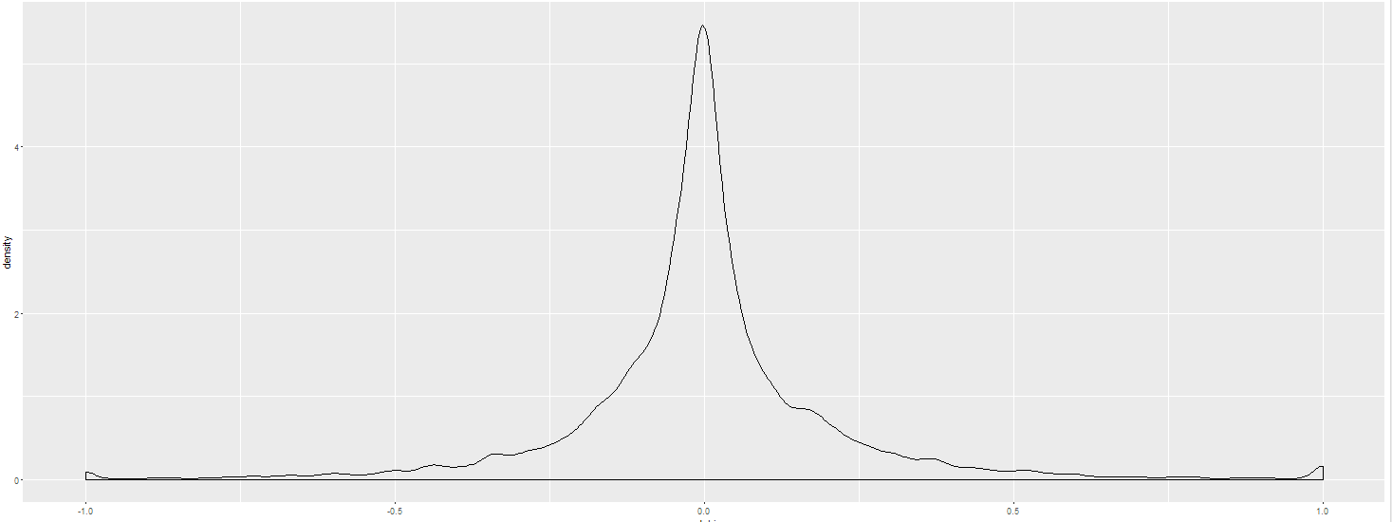
Result
Proposed model: 1-day moving-average of the deviation between served data in RS and in MySql.
Mean absolute prediction error on sample data: 13%.
A safety margin of 15% will result in 15% of cases over-estimated.
A safety margin of 20% will result in 10% of cases over-estimated.
Calculating safety margin per network may improve the result

Slide 3
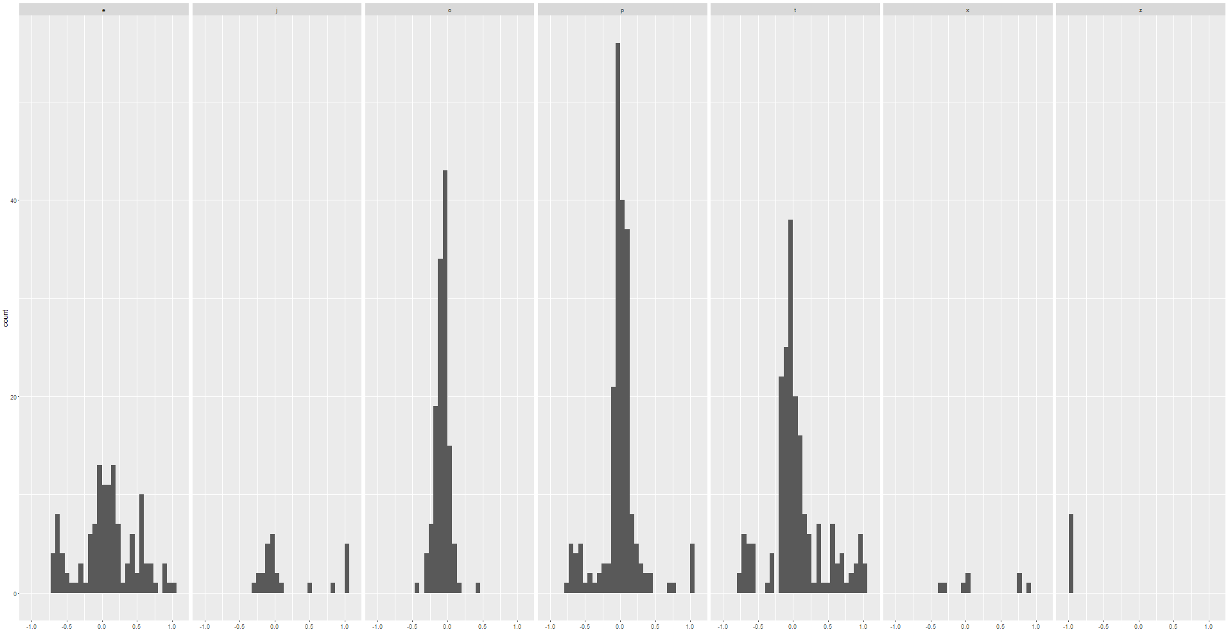
Deviation per network (count of rows with each deviation between -1 and 1)
OpenX
Index
AOL
Pubmatic
PulsePoint
Adx
Smaato
0’s in redshift
0’s in mysql

Slide 4
Important notes
For the dates 3/3 – 5/3, far fewer served events appeared in RS than actual number. This affected almost all placements and networks. “Representation rate” dropped on these days from around 90% to about 40%. These dates were ignored in the analysis presented in earlier slides.
AOL deviations have a similar pattern (deviation per day) across many placements from several users. This non-random effect should be investigated. See next slide.
Smaato deviation is -98%, i.e. less than 2% of served events are detected.
MySql data was substantially incomplete for both 13/3 and 14/3 (data was retrieved early afternoon on 15/3).

Slide 5
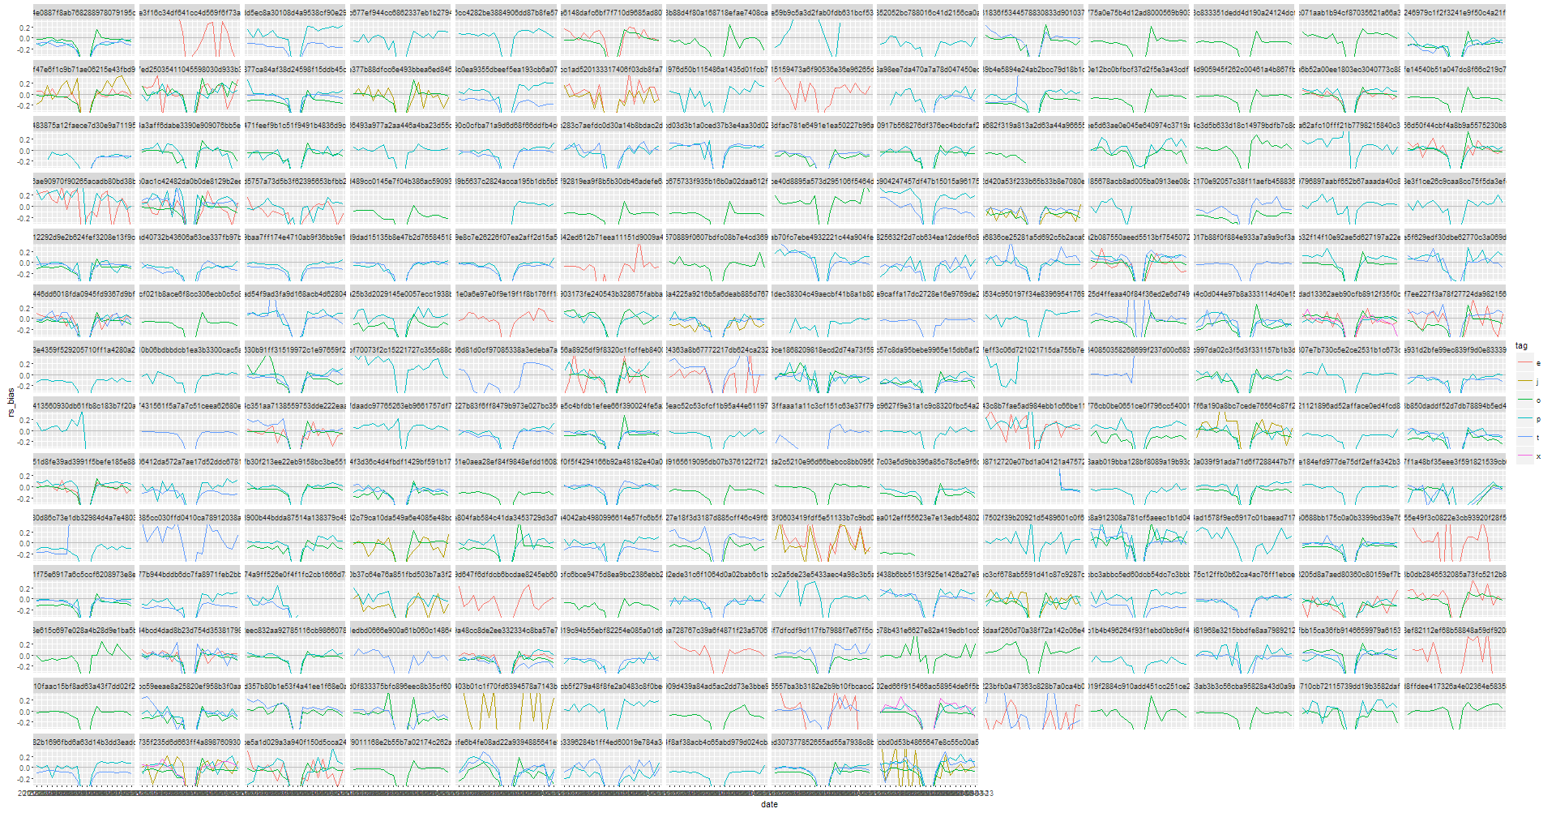
Deviation time-series: tile = placement, color=network. The “bad days” are the dip in the middle of each x-axis. Placements with similar AOL pattern are circled.

Slide 6
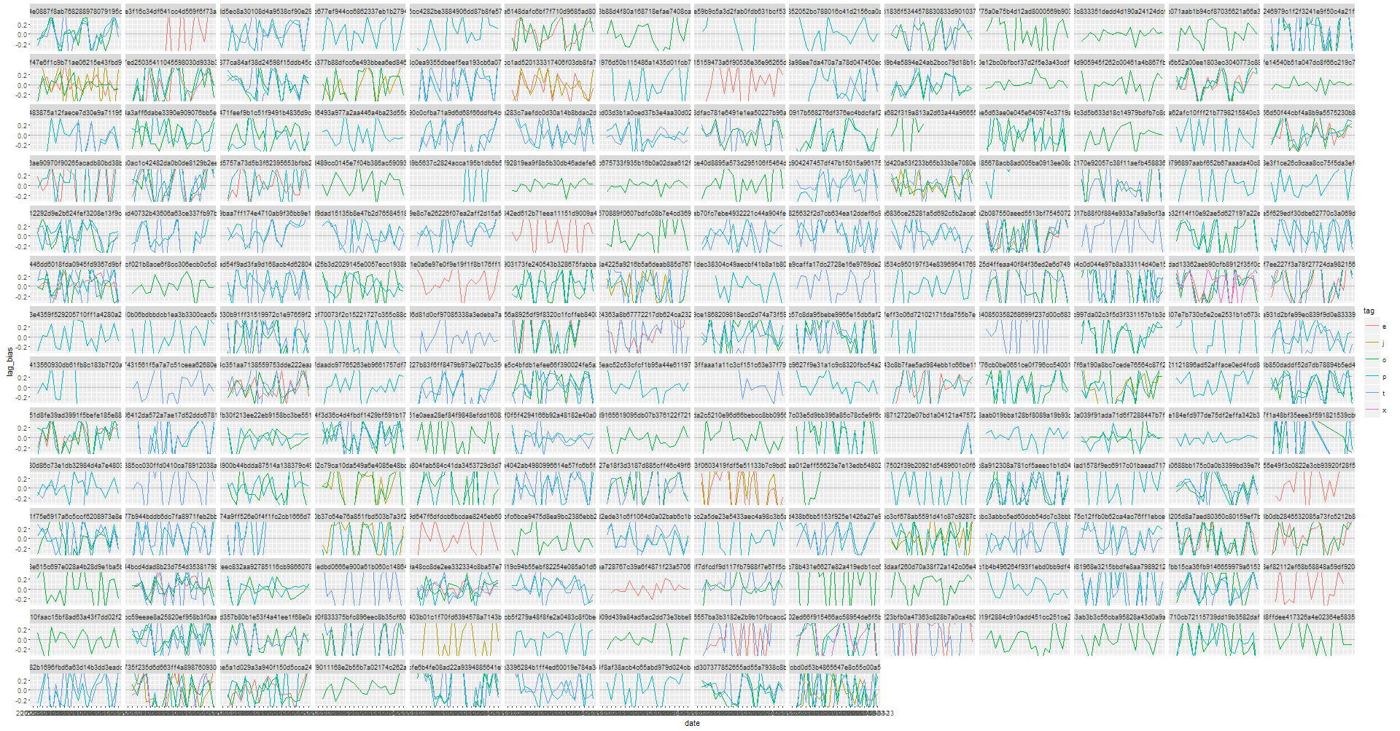
served day over day relative change: tile = placement, color=network

Slide 7
Technical details
RS rows:
Total: 25763
Served network == “h”: 5399
Served network blank: 5387 (21%)
--> Rows expected to be matched in mysql: 14977
RS rows unmatched by a corresponding MySql row: 999, most of them from 13/3 and 14/3 (data was collected on 15/3).
Rows from MySql with at least 10 served, but no matching RS data: 22 rows.
16 of them are smaato.
Average served count in these 22 unmatched rows: 97.

